Slide 1


WF Meta
Customer briefing
Recognises a customer's face, greets them, and briefs the RM on accounts and recent activity in answer to a spoken question.
A hands-free assistant for bank relationship managers, built on Ray-Ban Meta glasses
Document intelligence
Reads a document the RM is looking at, explains it, flags risks and answers follow-up questions.
On-phone
2
Text only
face recognition and document reading: images never leave the phone
switchable AI backends: local Gemma 3 or Meta Muse Spark 1.1
is all the AI model receives, over a direct USB link to the Jetson
All customer data in the demo is fictional
Notes:
WF Meta gives a relationship manager two hands-free abilities: a briefing on the customer in front of them, and an explanation of any document they look at. Face recognition and text reading happen on the phone; only text goes to the AI model.

Slide 2




How it works, in three steps
STEP 1 · META GLASSES
STEP 2 · ANDROID PHONE
STEP 3 · NVIDIA JETSON
See and hear
Recognise and read
Answer
Streams the live camera view
Photographs the document in front of the RM
Hears the RM's question and speaks the answer
Matches the customer's face to their profile
Reads the text of the document
All of this happens on the phone itself
Receives text only, over a direct USB cable
Default: Gemma 3, running locally and offline
Option: Meta Muse Spark 1.1, one setting away
Private by design: customer faces and documents never leave the phone. The AI only ever sees text.
Notes:
Walk through one step per click. Glasses: see and hear, nothing more. Phone: recognises the customer and reads the document on the device, so images never travel. Jetson: answers using only text, with local Gemma 3 by default or Meta's Muse Spark 1.1 if switched on. Close on the privacy point.

Slide 3
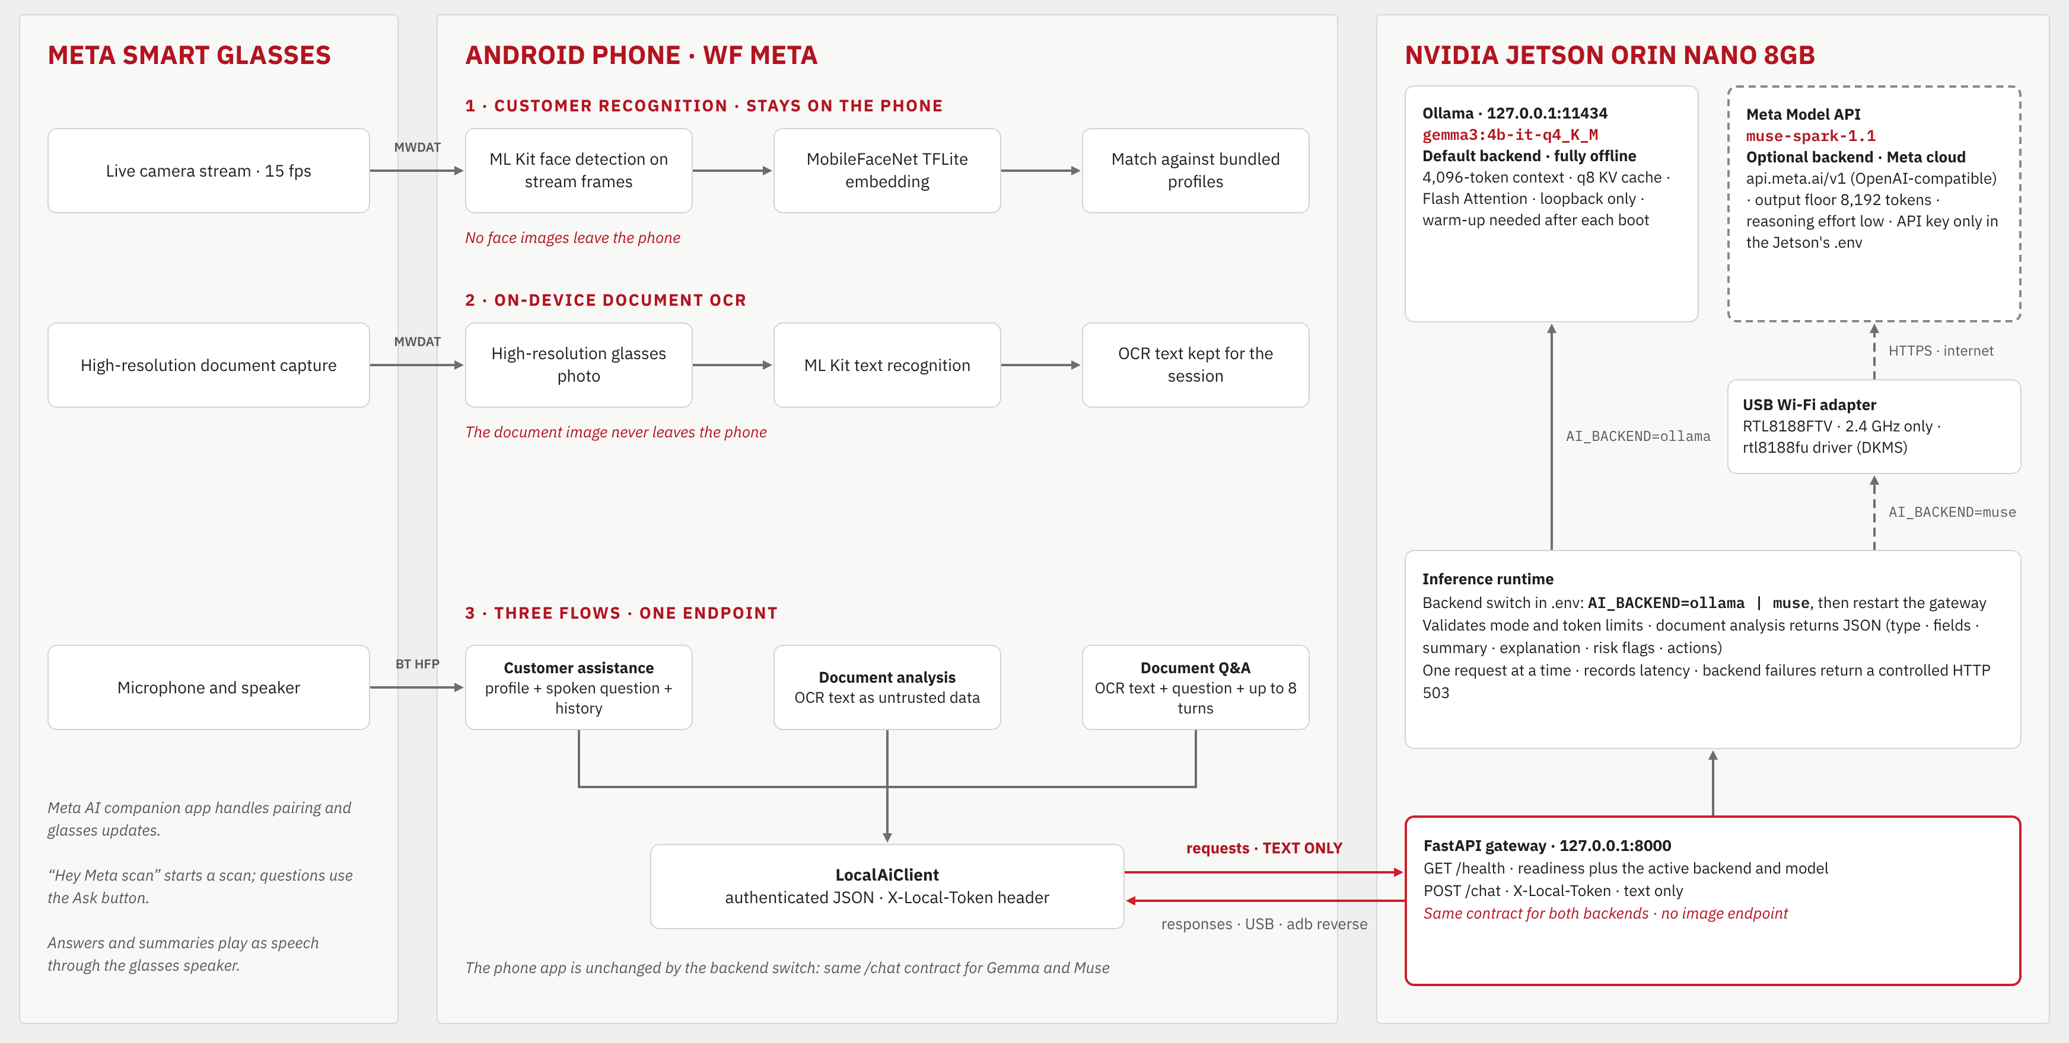
Under the hood: technical architecture
Notes:
Left: the glasses stream video, capture photos and carry audio. Middle: the phone recognises faces and reads document text itself; only text is sent on. Right: the Jetson gateway answers using local Gemma 3 by default, or Meta's Muse Spark 1.1 when AI_BACKEND is set to muse. The phone app is identical in both modes.

Slide 4



Live demo
Three things WF Meta does for a relationship manager
1
2
3
Recognise the customer
Read a document
Answer spoken questions
Spots the customer on the live camera and briefs the RM on their accounts.
Reads the page the RM is looking at, explains it and flags risks.
Replies through the glasses speaker, so the RM keeps eye contact.
All customer data in the demo is fictional
Notes:
WF Meta turns Meta smart glasses into a relationship manager's assistant. Three jobs: recognise the customer from the live camera stream, read a document the RM looks at, and answer spoken questions about either. Everything is spoken back through the glasses speaker, so the RM keeps eye contact with the customer instead of looking at a screen. Customer data in this demo is fictional.

